Slide 1
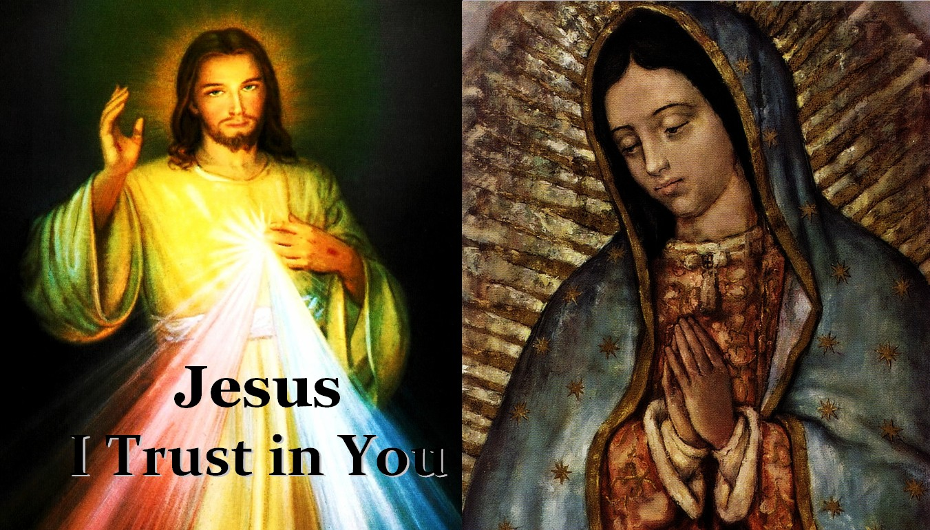
“Behold
Your Mother”
-John 19:27

