Slide 1
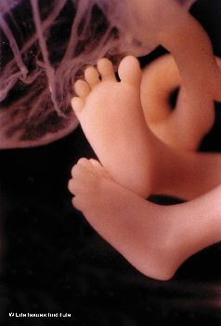

Abortion Quick Facts:
1st Trimester Baby’s Feet:
Over 1/3 of women report abortion pain as at least “severe” (worse than a bone fracture.) Patients statistically find abortion more painful than doctors expect.
Almost half of all abortions result in complications, including hemorrhage, cervix laceration, bowel perforation, and serious infection. 22% result in a later and intended pregnancy miscarried. Hundreds of women have died from “safe, legal” abortions.
Millions of loving American couples are waiting in line to adopt babies
We are outside praying for you and would love to talk with you!
God loves you and the child in your womb loves you. You have nothing to fear by having your baby
Women always deeply regret their abortions, but you will never regret bringing a life into this world.
We have help for you all along the way
Choose Life!
Call this number now! 800-395-HELP (1-800-395-4357)
Abortion Quick Facts:
1st Trimester Baby’s Feet:
Over 1/3 of women report abortion pain as at least “severe” (worse than a bone fracture.) Patients statistically find abortion more painful than doctors expect.
Almost half of all abortions result in complications, including hemorrhage, cervix laceration, bowel perforation, and serious infection. 22% result in a later and intended pregnancy miscarried. Hundreds of women have died from “safe, legal” abortions.
Millions of loving American couples are waiting in line to adopt babies
We are outside praying for you and would love to talk with you!
God loves you and the child in your womb loves you. You have nothing to fear by having your baby
Women always deeply regret their abortions, but you will never regret bringing a life into this world.
We have help for you all along the way
Choose Life!
Call this number now! 800-395-HELP (1-800-395-4357)
Abortion Quick Facts:
1st Trimester Baby’s Feet:
Over 1/3 of women report abortion pain as at least “severe” (worse than a bone fracture.) Patients statistically find abortion more painful than doctors expect.
Almost half of all abortions result in complications, including hemorrhage, cervix laceration, bowel perforation, and serious infection. 22% result in a later and intended pregnancy miscarried. Hundreds of women have died from “safe, legal” abortions.
Millions of loving American couples are waiting in line to adopt babies
We are outside praying for you and would love to talk with you!
God loves you and the child in your womb loves you. You have nothing to fear by having your baby
Women always deeply regret their abortions, but you will never regret bringing a life into this world.
We have help for you all along the way
Choose Life!
Call this number now! 800-395-HELP (1-800-395-4357)

